Slide 1
GROUP LEADERS
JANUARY 2023

Slide 2
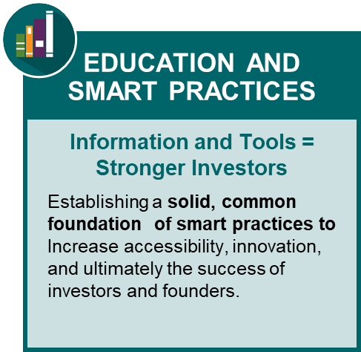
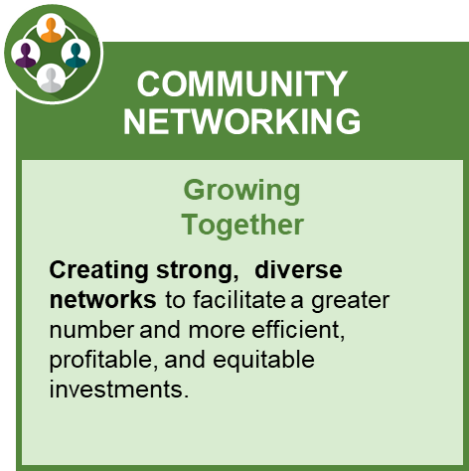
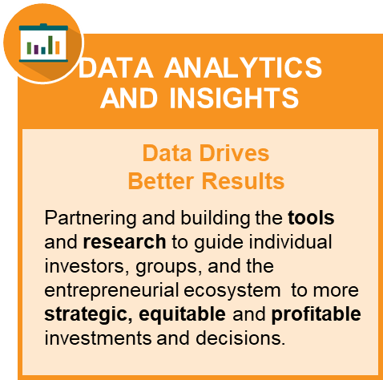
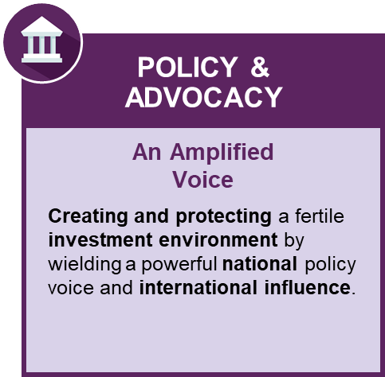
ACA Strategic Pillars
ACA’s support of investors and the early-stage ecosystem is focused on our strategic pillars:
Angels fuel entrepreneurs who fuel new job creation.

Slide 3
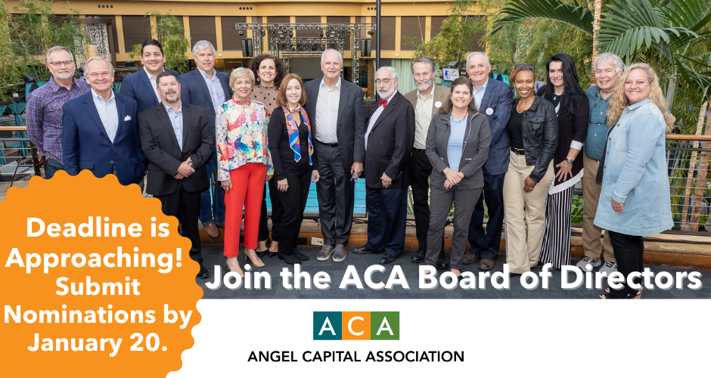
Ways to Get Involved!
Go online to see more details and instructions!
3

Slide 4



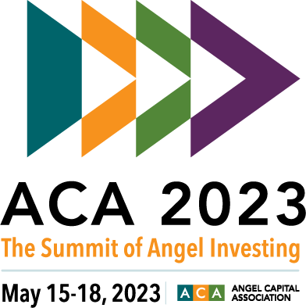
Ways to Get Involved!
Volunteer Opportunities:
Data Analytics and Insights Committee
Education Committee
Membership & Marketing Committee
Public Policy Committee
Angel University
Webinars
Blog Articles
Summit Planning Committee
Awards Committees:
  Luis Villalobos
Angel Investor Foundation
Board of Directors
Dean of Faculty
4

Slide 5
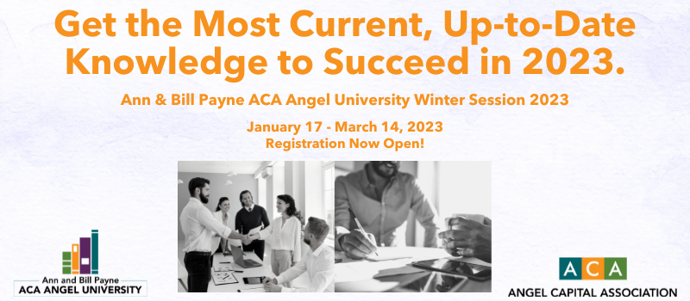
Education and Smart Practices
Angels fuel entrepreneurs who fuel new job creation.
5

Slide 6

Ann and Bill Payne’s ACA Angel University: Learn How To Be A Successful Angel Investor In Convenient Two-Hour Courses.
    Winter 2023 - Basics
      Fundamentals of Angel Investing – January 17
      Risks in Angel Investing – January 24
      Angel Returns and Portfolio Strategy – January 31
      Due Diligence Workshop – February 7
      Valuation Workshop – February 14
      Term Sheet Basics – February 21
    Winter 2023 – Deeper Dive
      Advanced Workshop on Capitalization Tables – February 28
      Startup Boards Workshop – March 7
      Angel Exit Strategies – March 14
    Learn more at - angelcapitalassociation.org/aca-angel-university/
    Ann & Bill Payne ACA Angel University at the ACA Summit: May 15-16, 2023
@2022 by Angel Capital Association. All rights reserved. No part of this publication may be reproduced in any form or by any means – graphic, electronic, or mechanical, including photocopying, recording, taping, and information storage and retrieval systems – without the express written permission of Angel Capital Association.

Slide 7


Community Networking
COMMUNITY NETWORKING
ACA Peer Groups
  Clean Tech
  Life Sciences
  Growing Women’s Capital
  Impact Investing
  Regional Connections
Syndication Opportunities in 2022
ACA Connect
Member News
Share Your Great News!
Growing
Together
Creating strong, diverse networks to facilitate a greater number and more efficient, profitable, and equitable investments.
7

Slide 8
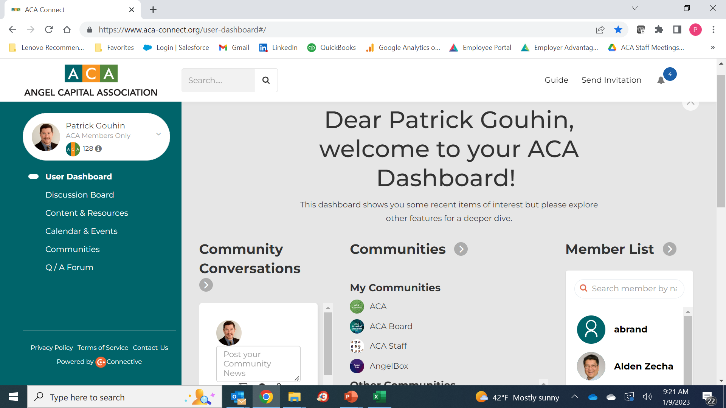

Slide 9
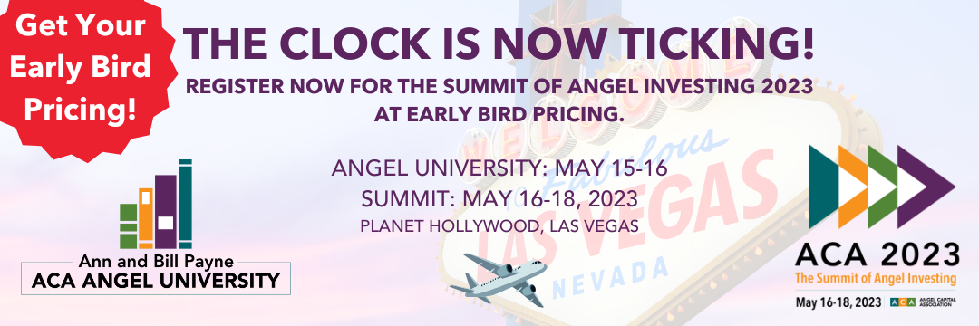
Community Networking ACA 2023: The Summit of Angel Investing
Ecosystem Development and Support
Emerging Global Trends
Group Leaders
Host Investment Sectors – Including Life Sciences
Timeless Investing Education

Slide 10

Policy & Advocacy
POLICY &
ADVOCACY
  Work in coalition on important issues for early-stage ecosystem
  Leaders of Influence: SEC Investor Advisory Committee
  Investors of Influence: NIH, FDA, NSF
  Accredited Investor Definition
    Resist changes to financial thresholds
    Push for financial sophistication measures
      Angel University accreditation, Underserved community focus
  QSBS-Sec. 1202 (also 1244 and 1045)
    Preserve current tax treatment and move to offensive position
      Sustain coalition support, Emphasize entrepreneur impact
    Reduce holding period from 5 to 3 years
    Incorporate convertible debt
    Possibly apply to LLCs and S corps., not just C corps.
  Fund caps
    Expand from $10M/250 to $50M/500
An Amplified
Voice
Creating and protecting a fertile investment environment by wielding a powerful national policy voice and international influence.

Slide 11
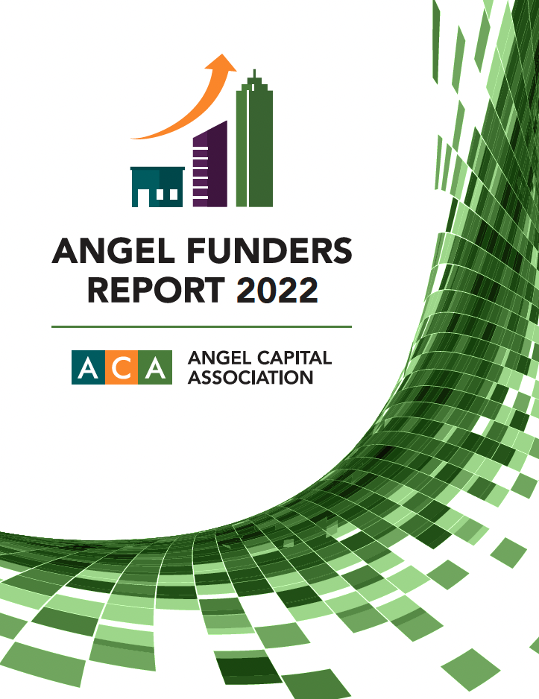
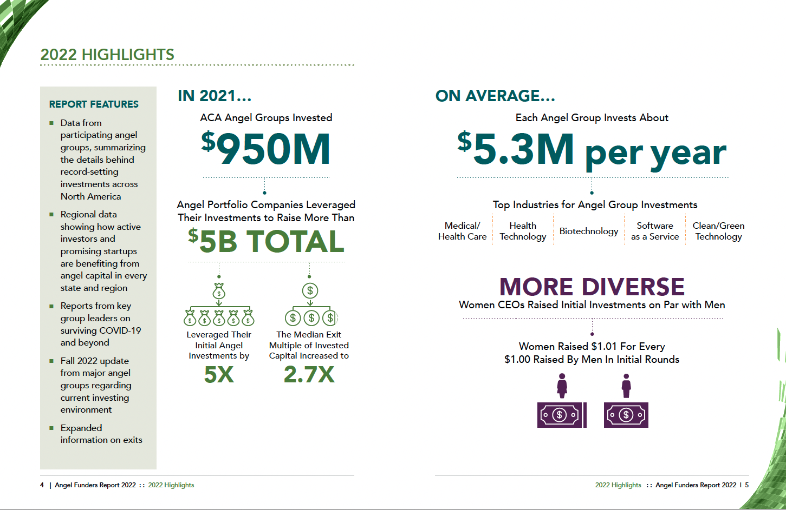
Data Analytics and Insights: Angel Funders Report

Slide 12

The AIF: a Wholly-Owned 501(C)3 Subsidiary
The AIF: a Wholly-Owned 501(c)3 Subsidiary
Highlights to Date:
Have raised nearly $1 mil of a $2.3 mil goal
Hired an Education Director, Dr. Margie Bacheler who has helped to launch incredible education programs, works to develop opportunities for more angels and entrepreneurs to attend the Ann & Bill Payne Angel University.
Hired a marketing expert, Dannielle Stewart, who is working to curate communications, promote angel investing and work on strategic marketing and storytelling.
About the AIF: Our mission is to advance the art and science of angel investing to accelerate innovation and economic growth. AIF serves both aspiring entrepreneurs and anyone interested in angel investing whose purpose is to increase and diversify our economic ecosystem and to help bridge racial and gender wealth gaps.
Page 12

Slide 13
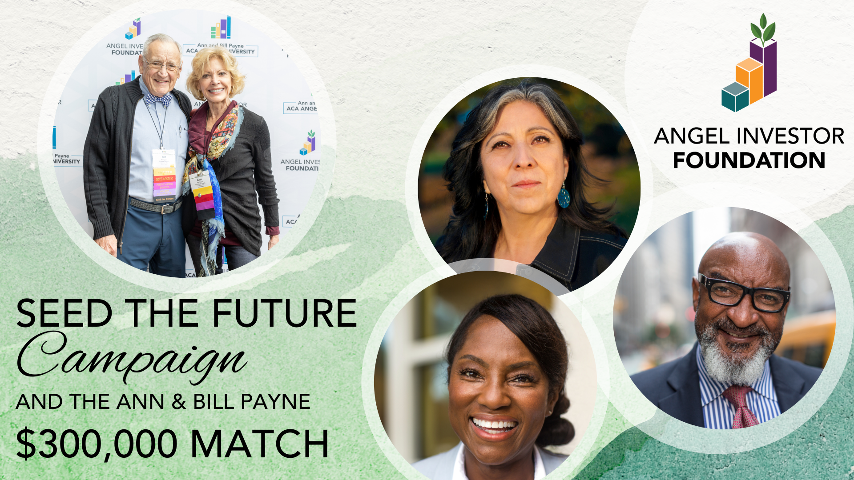
The AIF: a Wholly-Owned 501(c)3 Subsidiary
The AIF: a Wholly-Owned 501(c)3 Subsidiary
Improve educational programs and data analysis for angels and entrepreneurs
Strengthen syndication networks and deal flow
Create targeted programs for underserved and unrepresented communities to expand investments and business support
Enhance membership benefits and ACA infrastructure
Expand ACA membership to welcome the growing community of newer early-stage investors
Page 13

Slide 14
Questions?
Sarah Dickey – sdickey@angelcapitalassociation.org

